Slide 1
The Senior Internship Experience
How a College Program
for Students with IDD
Develops Meaningful Career preparation Experiences.
Rick Blumberg, PH.D CCS AFFILATED FACULTY
Rebecca Daley, M.S. CCS Director
Amy K. SChuler, MAT CCS VOCATIONAL COORDINATOR

Slide 2
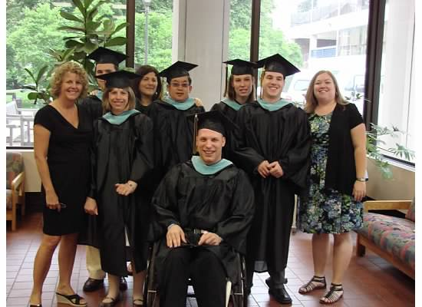
CCS Program Attributes
Approved CTP program
Full-time four year program
Ages 18-25 at time of admission
Cohort model
Mentor supported
Matriculating non degree
bearing status
Certificate from TCNJ

Slide 3
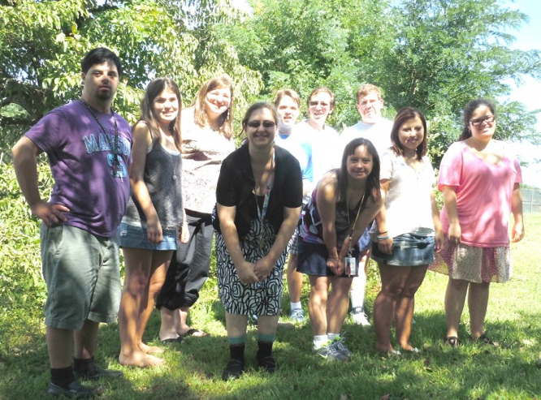
CCS Student Body
First cohort Fall 2006
23 student graduates
Currently enrolled 37 students
Residential /off campus housing 33/
12 individual houses
Funding resources
DDD Real Life Choices
School District
FAFSA eligible Pell Grant
TCNJ Scholarship
Notes:
School districts 6
DDD 14
Private 13
Scholarship 1

Slide 4
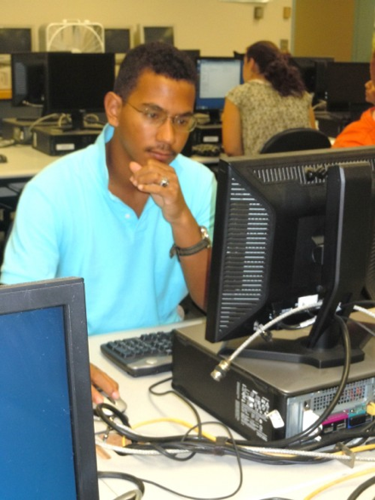
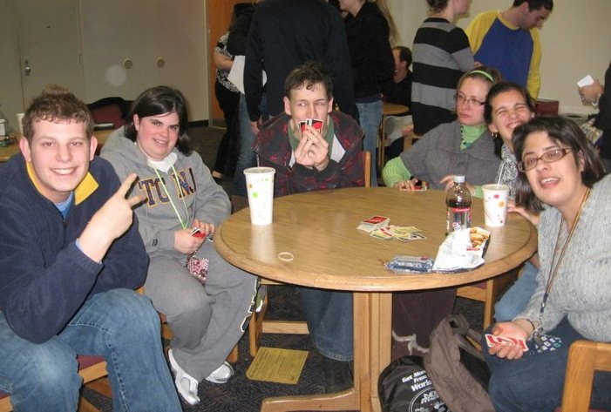
CCS Components
Liberal Learning
CCS Core Curriculum
Inclusive TCNJ coursework
Career Exploration
Academic Component
On campus practicum
Community Internship
Socialization/Self Determination
Extracurricular activities
Independent living

Slide 5
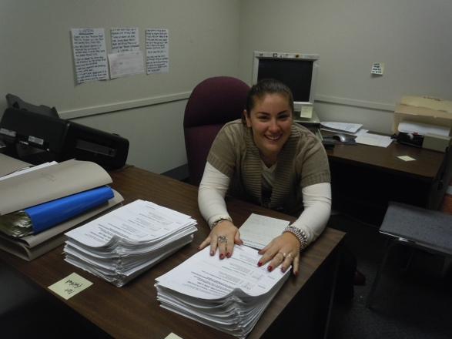
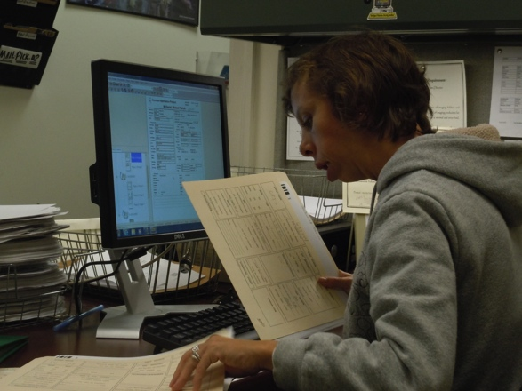
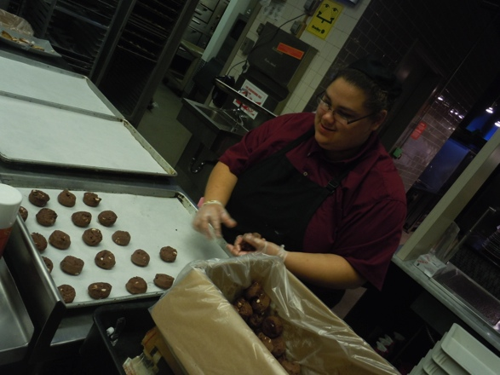
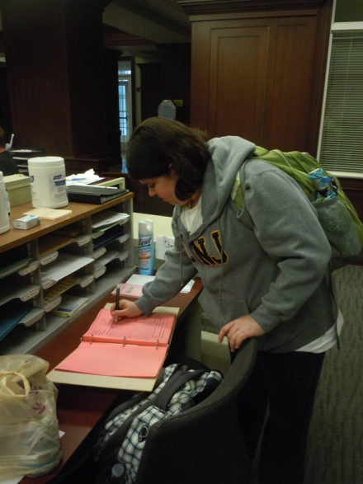
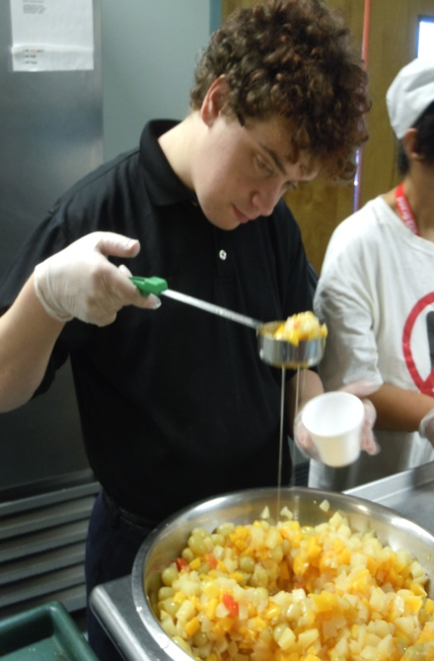
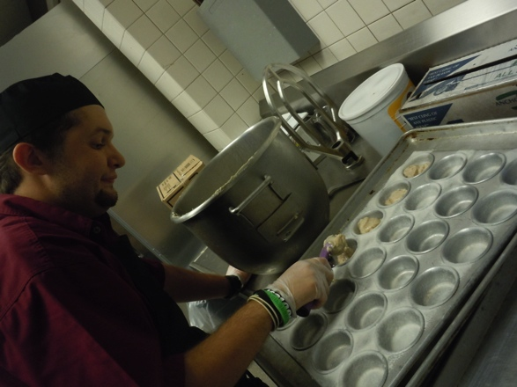
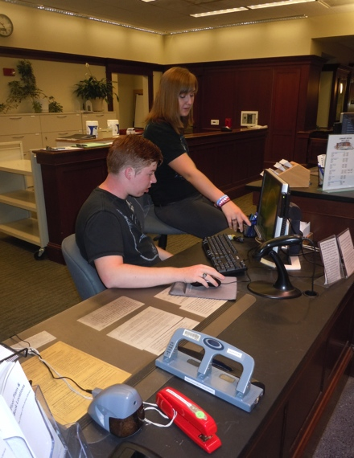
The
CCS Vocational Experience
Notes:
Hello, I am Amy Schuler, the Career Specialist at CCS. As Rebecca mentioned we have many elements of our 4 year program.. One being career development. This slide shows students from our soph, jr and senior cohorts at their work places on or off campus. We will tap into that a bit more but first it is important to understand the model that we based on our program on and the reason why we adopted it

Slide 6
The Need
We discovered early in the development of our program that:
most incoming freshman had little knowledge of their disability
had engaged in few career development activities in High School and so, had little information upon which to develop meaningful career goals.
Notes:
During the development of the CCS program it became obvious to us to that the majority of our incoming students had little true understanding of their disabilities, little career development or vocational training and therfore did not have a good sense of what could be good career choices for them and what supports they might need to be successful.
In order to provide these reference points and a productive four year experience we adopted the career development framework outlined by the known career ____ Brolin.

Slide 7
Career Development
We adopted the career development stage framework articulated by Brolin (1997) in designing coursework and related experiences.
These development stages includes
Career Awareness
Exploration
Preparation
Assimilation
Career Development
Awareness
Exploration
Preparation
Assimilation
Notes:
Using the four stages defined by Brolin– Awareness, Exploration, Preparation and Assimilation.. We designed our four year career development structure incorporating academic and field related experiences.

Slide 8
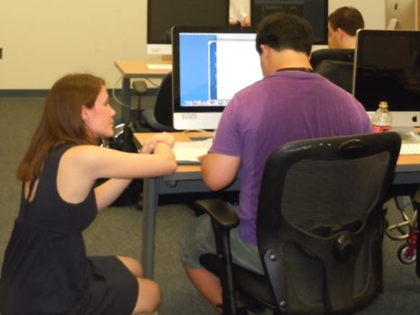
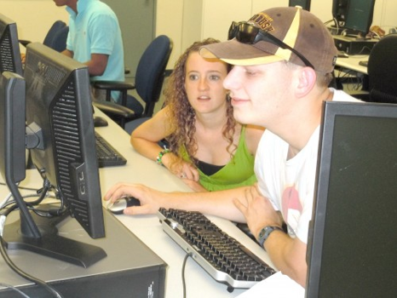
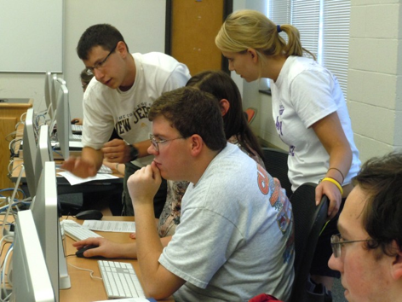
Career Awareness
Approached during Freshman year through self assessment and knowledge development activities.
Through Career Exploration coursework, students are exposed to content that addresses:
Why people work,
The benefits of employment,
Types of careers people engage in, &
Work expectations including:
Education
Training
Skill Requirements
Notes:
We address stage one- Awareness during Freshman year. Students take a two part academic course- Career Exploration I and II in the Fall and Spring term. This is considered the start of the career process.. With in depth discussion, research , group work and modeling about all aspects of career from what is the difference between a job and career.. An introduction to different categories and types of jobs (for instance a new an upcoming job sector– Green Jobs) to… work place expectations and problem solving. Our experience has shown that this type of in-depth review and candid conversation has typically not taken place in prior educational settings.

Slide 9
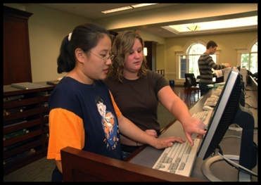
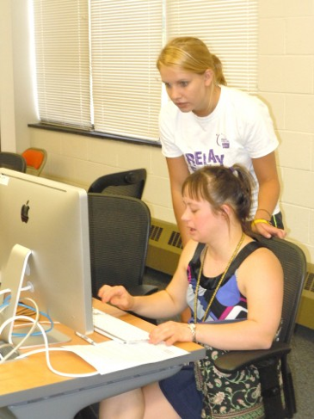
Self Assessment
Students begin to identify their:
Abilities
Interests
Preferences
An important outcome is the student’s developing an understanding of:
Market place needs/reality
Accommodations needed to be successful
Need for personal center planning/goals
Notes:
When the students move into the Spring semester course, they start to develop an understanding of what types of careers might interest them and which ones might suit their abilities (this may not necessarily turn out to be the same– so there is often a great self awareness experience by students during Career Exploration II course.) Students take many assessments to help define their personalities (myers briggs) work styles (NJ CAN) and spend time understanding tasks related to these jobs through .. ADD IN. With this better understanding and an awareness of the concrete tasks involved in jobs they might be interested students gain a sense of the type of supports they might need to be successful on and off the job this can range from --- to ----.

Slide 10
Career Exploration
Support Services | Food Services
Facility and Administrative Services | Health/ Hospitality/ Education
Retail Services | Office Services
In Sophomore year, students begin a series of brief on-campus work experiences in occupational “clusters”

Slide 11
Career Exploration
Sophomores choose experiences within these clusters based upon their individual interests and preferences
Work experiences are task analyzed so that job coaching can be effectively provided by peer mentors, and students receive clear feedback on their performance
These on-campus work experiences are generally the same offered other typically admitted undergraduates
Notes:
Based on information learned in Freshman year.. Sophomores begin HANDS ON exploration with semester long job experiences on campus. We try to gear students towards job cluster experiences that best suit their needs with the goal of having them experience four different clusters (two sophomore year and two junior) to offer a broad experience in different sectors. As we all likely know we may think we love one type of job till we are actually doing it or think we would dislike another and when engaged may love it.
When we develop these partners we spend time meeting with our on campus partners (who may be TCNJ employees or contract providers/as is the case with the food service on campus– Sodexo) to job carve the position so that our students will have meaningful and productive experiences. We use the job descriptions of typical undergraduate student workers to assist us in this process.
We provide mentor/job coach support with the hope to fade to natural support- once the student and employer are feeling comfortable and confident (this is the plan in the jr/sr experience as well)
The exploration stage during sophomore year tends to be an exhilarating and sometimes nerve-wracking experience for our students as it is often the first time they are held accountable for their performance in a work setting (or truly accountable)
Students work two days a week for 2-4 hour shifts.
Their job performance, dedication, behavior accounts for a large portion of this 4 credit course along with weekly class meeting and assignments.
We task analysis the jobs and use this information to provide on and off the job training and feedback for our students. We also look back on the individual supports defined during their freshman year/stage one experience (Awareness) and apply those to students as needed.
For this to be successful the student, job coach and employer need to be on the same page. XXX

Slide 12
Career Preparation
Conducted during Junior year with 1-2 on campus work experiences that reflect the student’s emerging career goals, and represent a good match between abilities, skills and preferences.
Career coursework focuses on resume development, interview skills and an exploration of available community based internships/employment opportunities
Notes:
Junior year.. Moves the students into the third stage of Brolins Career Development Framework--- PREPARATION. This is the time when we expand on the skills and preferences of the student.
Increase emphasis is placed on job placed based on Sophomore year experiences and exploration.
Students work two days a week at 3-5 hour shifts.
Students also attend a weekly class and individual meetings where they continue to reflect on their experiences and complete assessments that help them decipher what path they want to pursue for their year long – off campus Internship experience.
Emphasis is placed on developing career portfolio tools (resumes etc) and developing/practicing interview skills.
Our goal in this stage is to continue to develop skills and PREPARE students to take a more active and independent role in their choices and to be able to articulate their wants and strengths to their prospective employers– as they are required to interview for their senior experience as any typical rising senior would for theirs.

Slide 13
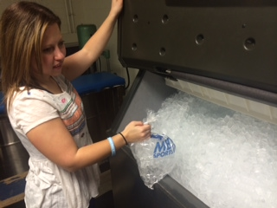
Practicum Examples
On Campus
Admissions Dept.
Atrium Dining Hall
Records & Registration
Mailroom/Receiving
Kids-Bridge Museum
Library Circulation
Public Relations
Media Technology
Athletics Dept./PT
Residential Life
Information Technology
Library Cafe
Risk Management Dept.
Notes:
This is a list of some of our current on campus /practicum and off campus /internship opportunities.
NAME A FEW
As you can see it is as rich and diverse as our student body and we continue to grow it to meet our incoming student’s needs and the needs of the job market.
Another area we continue to investigate and grow is on job supports and one of our wonderful CCS mentor/job coaches, Rachel Adelman, will be coming up now to describe this pilot research program to you.. ????

Slide 14
Career Assimilation
Is accomplished during senior year through an intensive (15 hr. per wk.) credit based internship Workplace support is provided by trained peer mentors and supervised by CCS Faculty.
Data is collected and reviewed with students to evaluate their performance, workplace accommodations, and the “match” between the student and job/career path
Students complete internship interview and complete all pre- post responsibilities
Notes:
The CCS program reaches the final stage in Brolins Framework during the senior year internship. This is true assimilation into the work place. Students are off campus THREE Days a week for full days.
Students are emersed in the corporate culture and learn to perform their tasks as well as gain a rich understanding of work place protocols and ettiquette (what do you do during a break, who do I eat lunch with? What happens if a coworker is absent)
Again– we job carve to provide a rewarding and supportive environment for our students. We provide mentor/job coach support with the hope of fading as the student becomes more confident and capable and natural support is established.
At the moment we have 6 seniors working off campus in a variety of jobs…
NJSNA, ETS, Arc of Mercer.. And most of our students are completely independent or will reach that mark by Winter break.
When I say independent that does not mean we are no longer involved, we still meet with the student and employer to assess progress, review supports and collect data.
We are always aware that conditions in the natural support structure and our students needs can change and we work very closely with our employers/students to keep the lines of communication open throughout the experience.
Having completed all four stages our goal is for our student to have understanding, development and experience in all the areas discussed and with this personal and vocational growth and hands on experience become a viable and important member of the work force.

Slide 15
Senior Internship Structure
Determine Interest/Job Fit
Assess Job- Job Analysis
Assess Tasks- Task Analysis
Take observational data on the types of prompts needed
Determine Individualized Needs
Create Support Strategy/Tools
Implement with Job Coach Support
Assist in Turn Over to Natural Support
Continue To Assess and Modify

Slide 16
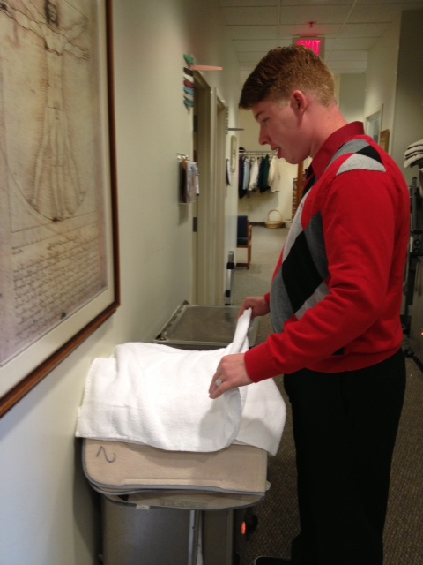
Internship Examples
Off Campus
NJ State Nursing Association
SONJ
Target
Educational Testing Services
Stepping Stone Day Care
Hopewell Physical Therapy
Wawa
NJ Credit Union
American Cancer Society
NJ State Dept. Disability Srvcs
Capital Health Medical Center
Wawa
Superior Court NJ
Notes:
This is a list of some of our current on campus /practicum and off campus /internship opportunities.
NAME A FEW
As you can see it is as rich and diverse as our student body and we continue to grow it to meet our incoming student’s needs and the needs of the job market.
Another area we continue to investigate and grow is on job supports and one of our wonderful CCS mentor/job coaches, Rachel Adelman, will be coming up now to describe this pilot research program to you.. ????

Slide 17
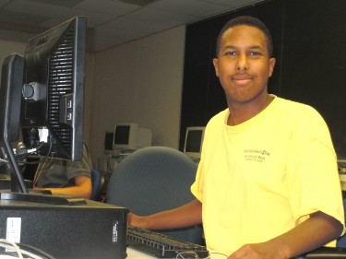
How do we Define a “Meaningful Sr. Internship Experience
Individual goals and accomplishments surrounding:
Academic Application
Skill and Task Development
Office Social Skills
Work Place Protocols
Increased Problem Solving
Conflict Resolution
Self Advocacy and Independence
EMPLOYMENT READINESS
Tools for Success, Independence and Sustainability

Slide 18
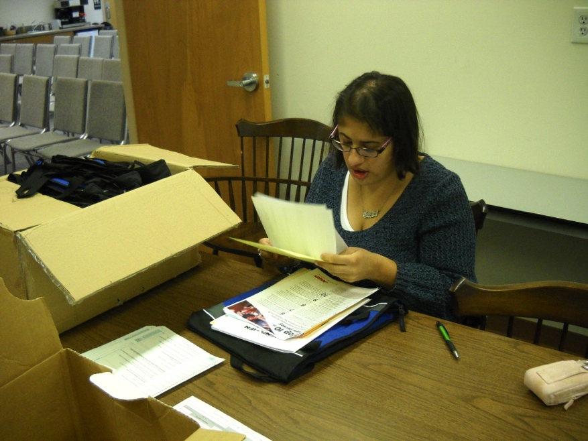
CCS Senior Internship Tools for Success, Independence and Sustainability
Meaning senior career preparation experiences
for review :
Authentic Learning Experiences
Technology Support
Peer Learning/Mentoring

Slide 19
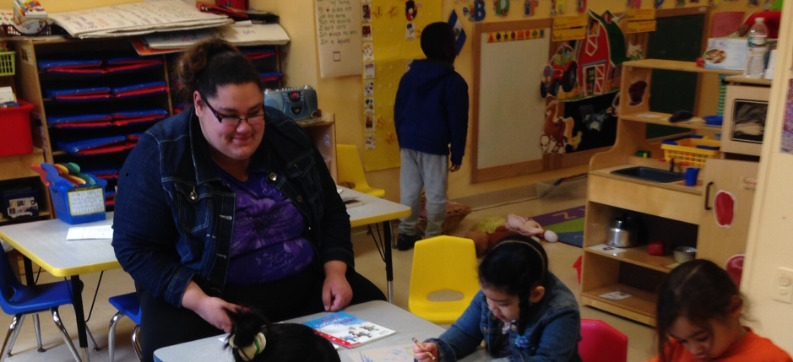
Authentic Learning- Sr. Internship Tools for Success, Independence and Sustainability
Correlate TCNJ Class with Internship Goals
Increase learning and understanding of “Big Ideas”
Increase possibilities of vocational experiences/success
There is an intimate and necessary relation between the process of actual
experience and education.
~ John Dewey, 1938
STUDENT: Graduating Senior
Stepping Stone Learning Institute, Trenton, NJ
Internship: Teacher Assistant, 4th grade class

Slide 20
Authentic Learning Experience
TCNJ Class: ECE 202- Theories and Practices of Early Childhood Education
LA/Science Lesson
Developed and Practiced on campus
Conducted at Internship
Provided Authentic Learning
Active Learning
Assisted with Processing of Information

Slide 21
Supports Research Based Theories
Theories of Research Based- Principles of Learning such as :
Goal-directed practice and targeted feedback are critical to learning
Meaningful engagement is necessary for deeper learning
Mastery involves developing component skills and knowledge, and synthesizing and applying
them appropriately
(2007, Eberly Center for Teaching Excellence, Carnegie Mellon)

Slide 22
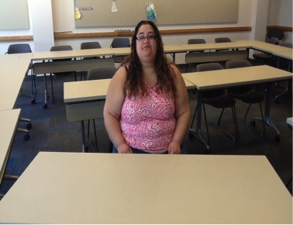
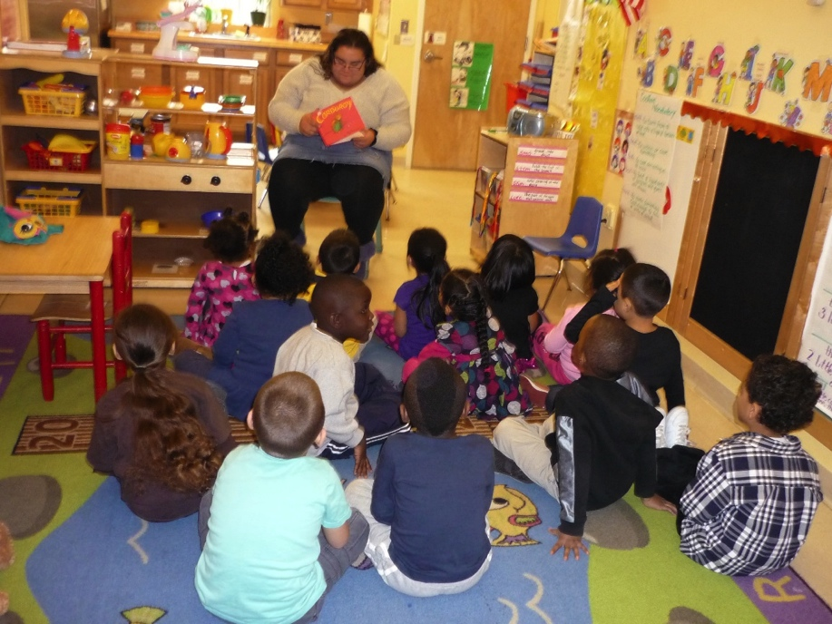
Class Room Application- Internship

Slide 23
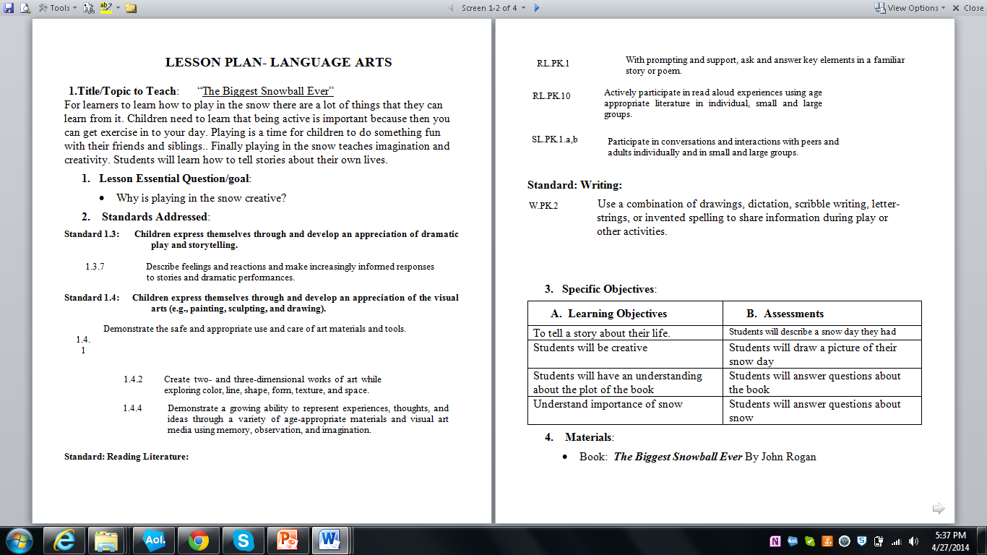

Slide 24
Observation Rubric
 | Exceptional | Proficient | Needs Improvement
Criteria
Lesson Objectives | Lesson objectives are performance based, connect to NJCCC standards, and challenge students to make deep conceptual connections. | Lesson objectives are performance based, connect to NJCCC standards, and reflect lesson content. | Lesson objectives are stated but are not performance based, do not connect to NJCCC standards or are extraneous to the lesson.
Subject Matter Knowledge | Lesson demonstrates deep content and awareness of conceptual connections. | Lesson demonstrates content competency and conceptual connections | Lesson reflects weak or inaccurate content knowledge or lacks conceptual connections.
Developmentally appropriate Practice | Content is age appropriate | Content is generally age appropriate | Content is not suitable for the student developmental levels
Preparation | N/A | TC is well prepared for lesson. It is evident that TC practiced and carefully created her lesson plans. | TC is not prepared for lesson. It is evident that TC did not practice.
Lesson Beginning | Is an activity that activates prior knowledge, stirs inquiry, launches, and connects to lesson. | Is an activity that activates prior knowledge, generates interest, launches and connects to lesson | Is an activity that does not activate prior knowledge, does not engage students, or does not connect to lesson.
Lesson Activities | Lesson activities are developmentally appropriate, creative, target student needs and interests, conceptually connect to one another, and successfully meet learning objectives. | Lesson activities are developmentally appropriate, generate interest, and are sound instructional choices that successfully meet learning objectives | Lesson activities are developmentally inappropriate, uninteresting, are poor instructional choices, or do not meet learning objectives.
Effectiveness of Communication/Classroom Presence | TC has good command of standard English; communicates effectively using voice, intonation, and non-verbal communication to enhance comprehension. TC has appropriate classroom presence. | TC has good command of standard English, but some lapses are noted; TC’s voice, intonation, non-verbal communication and classroom presence is generally appropriate. | TC has poor command of standard English; TC’s voice is too loud or soft, lacks enthusiasm or modulation; and/or fails to use non-verbal gestures; lacks appropriate classroom presence.

Slide 25
TCNJ Course Work- Supports Vocational

Slide 26
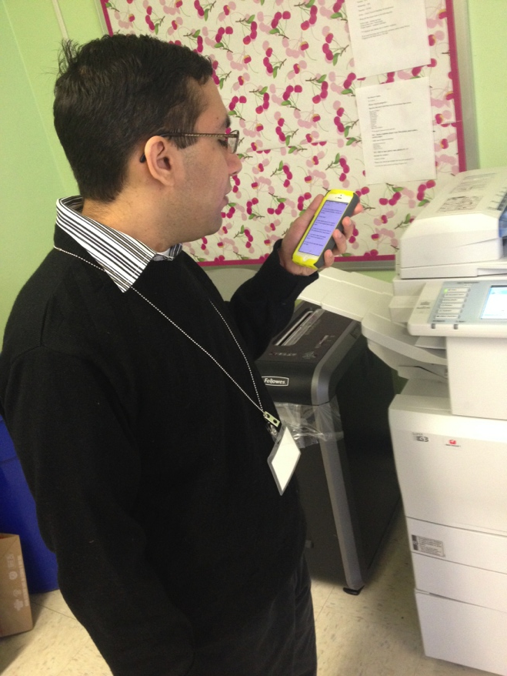
Technology- Sr. Internship Tools for Success, Independence and Sustainability
Provide Support through Technology that is normative, easily accessible and build independence
Areas of focus:
Social Skills/Communication Support
Problem Solving
Task Support and Development
STUDENT: Graduating Senior
Katzenbach School for the Deaf, Ewing NJ
Internship: Office Support, Child Study Team
Notes:
Resisted traditional support– wanted independence.

Slide 27
Technology as a Vocational Tool
Support Methods
Social Stories (priming intervention)
Social Scripts (direct/specific intervention)
Task Review
Task Analysis
Self Monitoring Check Lists
Different Functions on the iPhone:
Check Lists (Memo Icon)
Photos/Screenshots (Photo Icon)
Video Modeling (Video Icon)

Slide 28
Supports Research Based Theories
Recent surveys indicated the outcomes of competitive employment opportunities and retention of student’s with Autism is significantly lower than their peers (Wehman et. al , 2013)
Research indicated that these poor outcomes are directly associated with the deficits in social skills that these students possess (Moreover, O’Reilly , 2004)
Recent research suggests that VM can be used to successfully teach a variety of skills (academic, career, social, self care) to individuals with IDD. (Rehfelt at al, 2003; Mangiapello & Taylor, 2003; & Nikopolous & Keenan, 2003)

Slide 29
Social Skills/Problem Solving Support
Limited interaction with supervisors made it difficult to generate natural supports
Ability and work were under estimated due to the lack of interaction
Office social experiences were limited leaving a sense of alienation and lack of contribution
Communication and social skill deficits are central to Autism Spectrum Disorder. They play a role in unsuccessful post-secondary employment (O’Reilly et al., 2004).

Slide 30
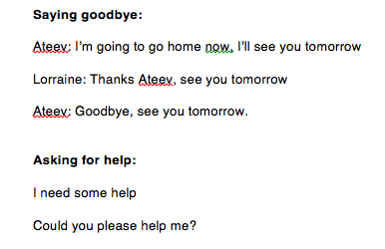
Social Skills and Problem Solving Support
Social Skill Task Analysis: Break down the social skill and problem solving into small manageable steps.
Social Scripts: Create a script together reviewing key elements of the work place.
Role Playing and Modeling: The Script and Video would be placed on iPhone for review independently before /during shift.

Slide 31
Problem Solving
Problem- Solution scripts and video on iphone
Color code solutions
Scripts have prompts to task sheets
Update as need based on tasks/real time experiences

Slide 32
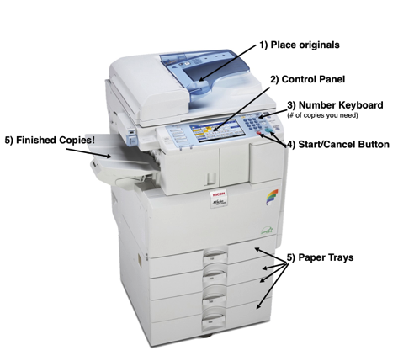
Task Completion Support
In order to support tasks, the student was given multiple checklists to follow.
All of these checklists were created by completing task analyses on each task
These checklists were created in the student’s
IPhone's “notes” section. Visual cues were provided when vocabulary was a challenge
By using only the IPhone, the student was able to discreetly follow steps to complete tasks at work, while also increasing his independence

Slide 33
Intern using technology for copier directions

Slide 34
Self Monitoring Support
Self Monitoring Rubric on iPhone.
Each shift, rate task productivity and social skills/problem solving interactions
Did the skill “all the time”
Did the skill “some of the time”
Did the skill “none of the time.”
Assistance in the beginning– then independently.
Demonstrated growth in both areas from when he first began his internship to the end of the semester
Notes:
We ask the employer and job coach to fill out similar reports. He demonstrated growth in all aspects by all parties.

Slide 35
Transportation Readiness- Sr. Internship Success, Independence and Sustainability
Transportation and mobility play key roles in the struggle for civil rights and equal opportunity in the disability community.
Affordable and reliable transportation allows people with disabilities access to important opportunities in education, employment, health care, housing, and community life
“For Americans with disabilities, no less than for all other citizens, the opportunity to earn a living and be self-supporting is a universally held goal.”
John R. Vaughn, Chairperson, National Council on Disabilities Act.

Slide 36
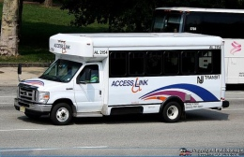
Transportation Readiness- Sr. Internship
Students responsible for transportation to/from Internship
Public and private options are limited
Best method available in NJ is Access Link
Para transit
Eligibility Based Service
Notes:
ALSO LIFE LONG TOOL!

Slide 37
Transportation Readiness Support
Model after S.O.E. Student Teaching Class
Cooperative and Collaborative Learning
L.I.F.E class incorporate peer modeling and mentoring to:
Increase understanding of service
Support application process/procedures
Develop skills for interview process
Understand/practice reservation system
Share best practices and tips

Slide 38
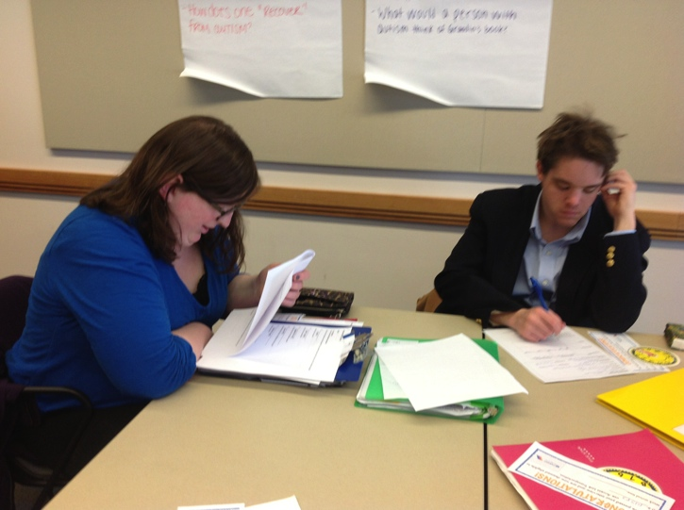
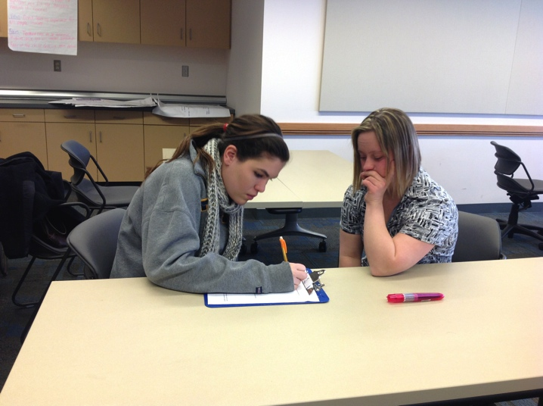
Peer Learning- Sr. Internship Skills
Peer learning gives students considerably more practice than traditional teaching and learning methods in taking responsibility for their own learning and, more generally, learning how.
(Making the move to peer learning, in Peer Learning in Higher Education: Learning From & With Each Other, by David Boud, Ruth Cohen & Jane Sampson.)

Slide 39
Peer Review- Application and Interview
Process
Questions
Important Information

Slide 40
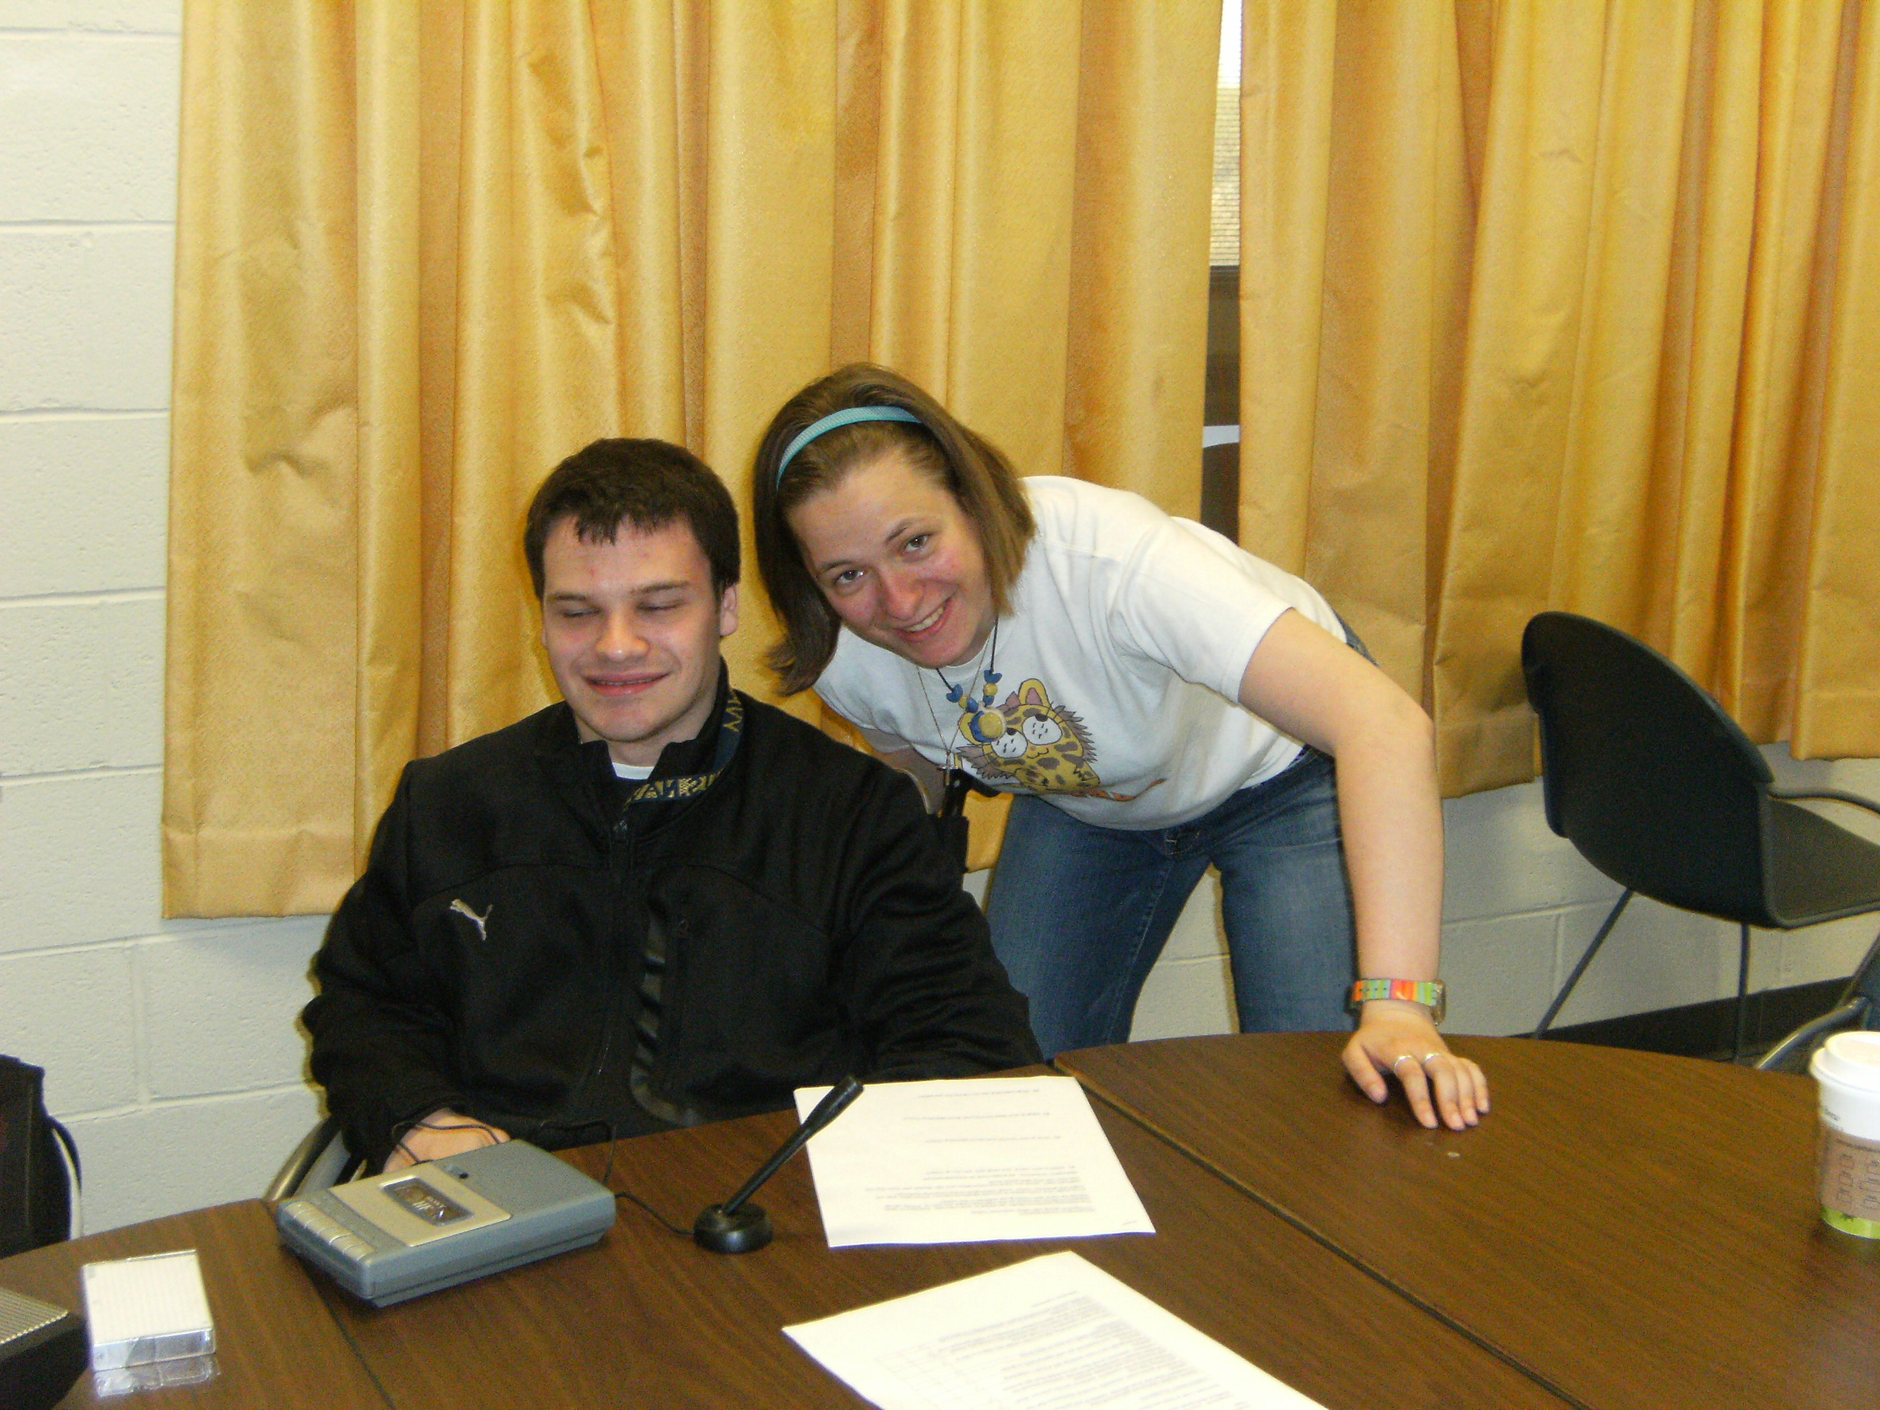
Peer Insight Understanding of Accesslink Service
Current Peer users created
Reservation Video
Reservation Recording
In class demonstrations
Demonstrate Process
Assist in Problem Solving
Allow for Role Playing

Slide 41
Peer Tips and Tricks

Slide 42
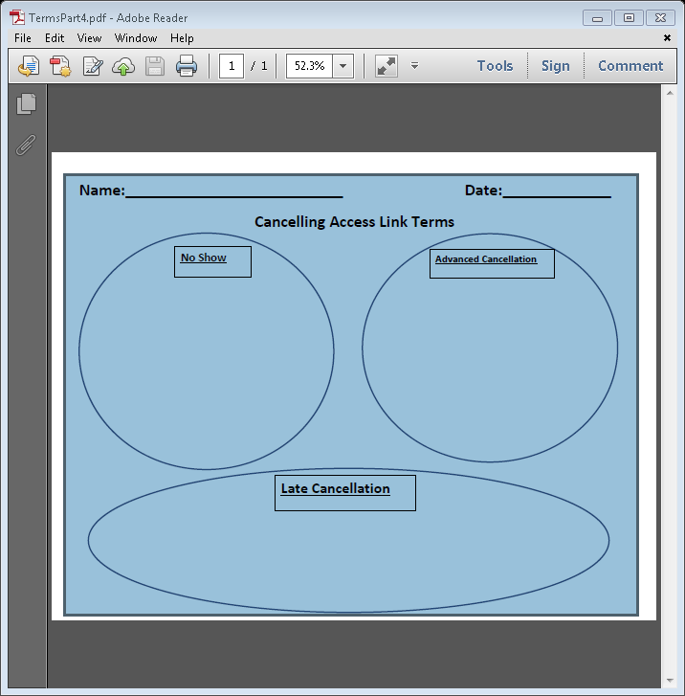
Peer Reinforcement Activities
Practice Activities/Review
Open Discussion

Slide 43
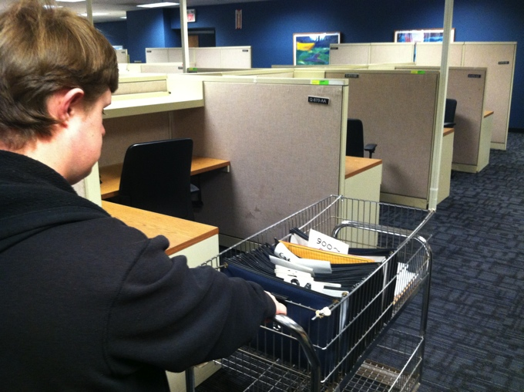
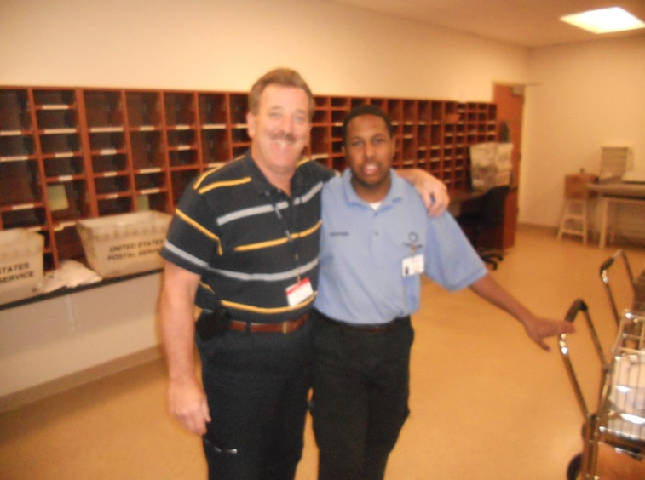
Senior Internship- Class of 2014 Tools for Success, Independence and Sustainability
“Higher education leads to a variety of personal
and financial benefits, and is an integral part of
establishing a successful career path and enhancing
earnings over a lifetime.” (Carnevale, Rose, & Cheah, 2011)

Slide 44
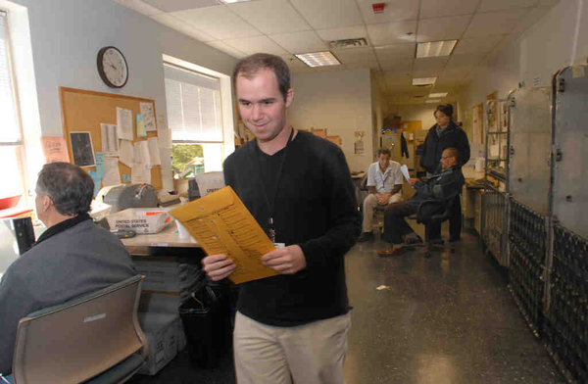
Question & Answers
For More Information
Rick Blumberg – blumberg@tcnj.edu
Amy K. Schuler- schuler4@tcnj.edu

